Slide 1
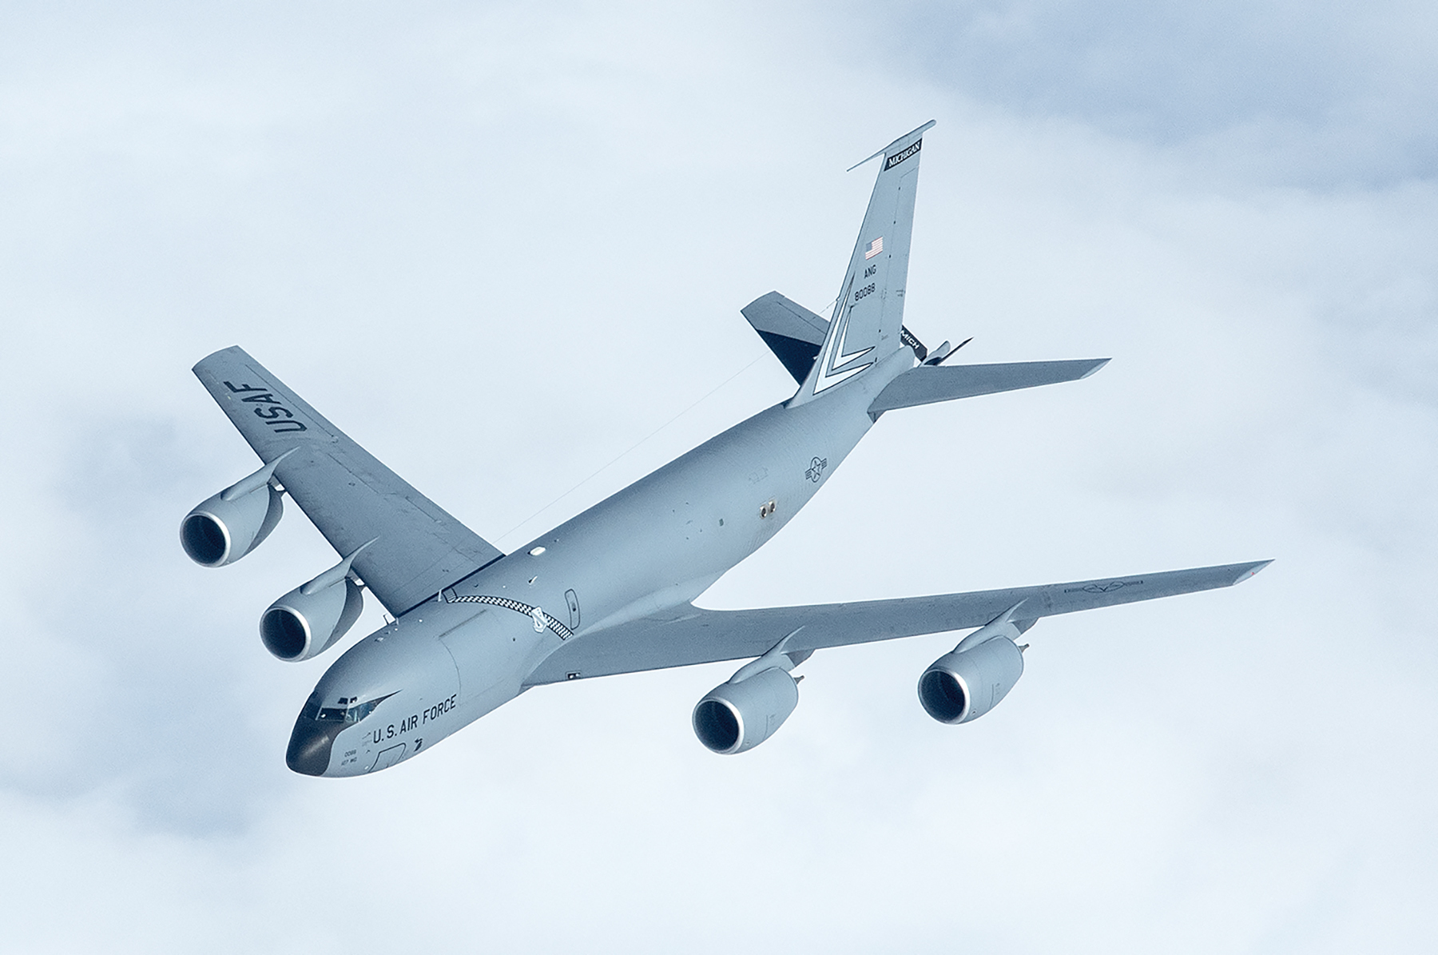
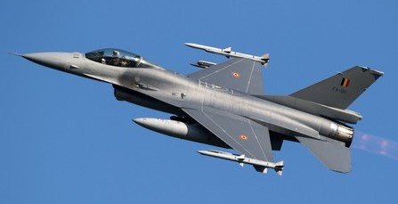
Hill AFB Aircraft Opportunities
KC-135
F-16

Slide 2
APU Turbine Engine: AS - Repair Hill AFB – 419th SCMS
MD: | KC-135
TMS: | N/A
Noun: | Auxiliary Power Unit (APU) Turbine Engine
NSN: | 2835-01-685-5852
P/N: | 4550063
Forecasted Buy Price: | $436,796.59
Forecasted Repair Cost: | $327,581.07
AAC: | C
Unserv. Assets Avail: | N/A
QPA/APPL Rate: | 2 | 100%
AMC/AMSC: | 3 | R
RMC/RMSC: | Not Available | Not Available
Material: | Not Available
Dimensions: | Not Available
Drawings Releasable: | No
Drawing #: | Not Available
Drawing Cage Code: | Not Available
T.O. Releasable: | Yes
T.O. #: | 2G-T62T-43/-44
Budget Code: | 8
Next Higher Asmbly: | Quick Start Auxiliary Power System (QSAS)
Out Year Requirements: BUY
FY25: | 0 | FY26: | 0 | FY27: | 0 | FY28: | 0 | FY29: | 0
Out Year Requirements: REPAIR
FY25: | 36-60 | FY26: | 36-60 | FY27: | 36-60 | FY28: | 36-60 | FY29: | 36-60
EDL: | Available |  |  |  |  | RDL: | Not Available
Tinker | 08/08/2024 |  |  |  |  | Robins | 03/29/2024
Hill | 12/06/2024, 2023 |  |  |  |  | Virtual | ------
Comments
Deliverables: Source Approval Request (SAR) Package
Interested vendors should submit a Source Approval Request (SAR) to AFSC.OL.SB@us.af.mil and include your email address and “request a drop off”. A request for drop off will be returned, use this to submit your SAR package.

Slide 3
APU Turbine Engine: AS - Repair Hill AFB – 419th SCMS
Additional Comments
In the past 5 years, the current source has struggled to overhaul KC 135 APU to meet Air Force requirements, resulting in increased backorders. A supplementary overhaul source would alleviate both the backlog of backorders and help maintain a constant supply of APUs to the warfighter.
A licensing agreement with Pratt and Whitney must be obtained in order to request available drawing from the Public Sales Office.

Slide 4
Additional Hill AFB Aircraft Opportunities
C Model Solar: Reverse Engineering – F-16
NSN: 1560-01-462-2040, P/N: 5004550-09
C Model Clear: Reverse Engineering – F-16
NSN: 1560-01-462-4551, P/N: 5004550-11
D Model Fwd Clear: Reverse Engineering – F-16
NSN: 1560-01-497-6599, P/N: 5006550-01
D Model Aft Solar: Reverse Engineering – F-16
NSN: 1560-01-497-5078, P/N: 5004270-03
D Model Fwd Solar: Reverse Engineering – F-16
NSN: 1560-01-497-5956, P/N: 5006550-03
D Model Aft Clear: Reverse Engineering – F-16
NSN: 1560-01-497-5959, P/N: 5004270-01

Slide 5
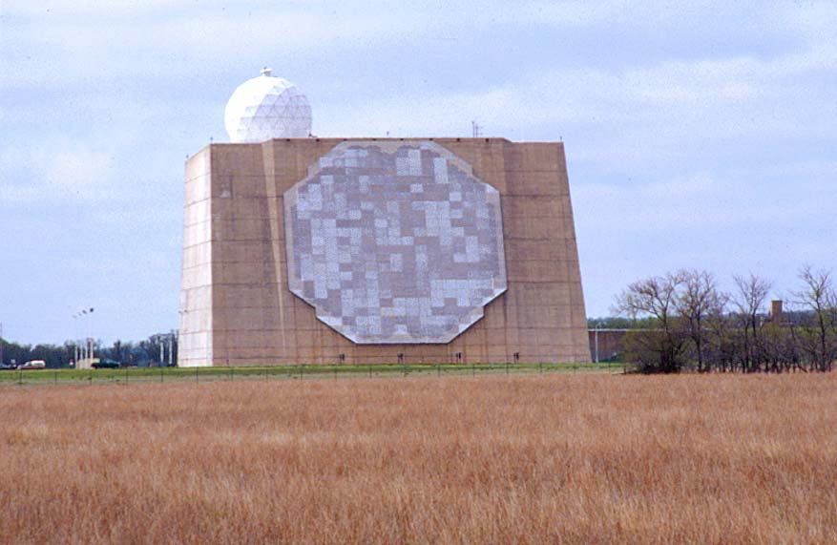
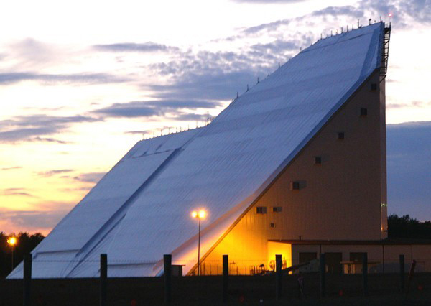
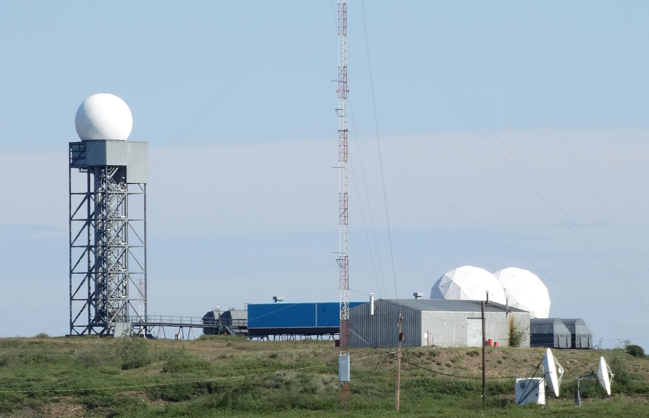
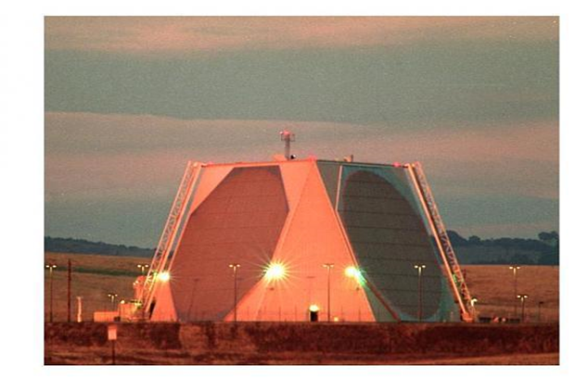
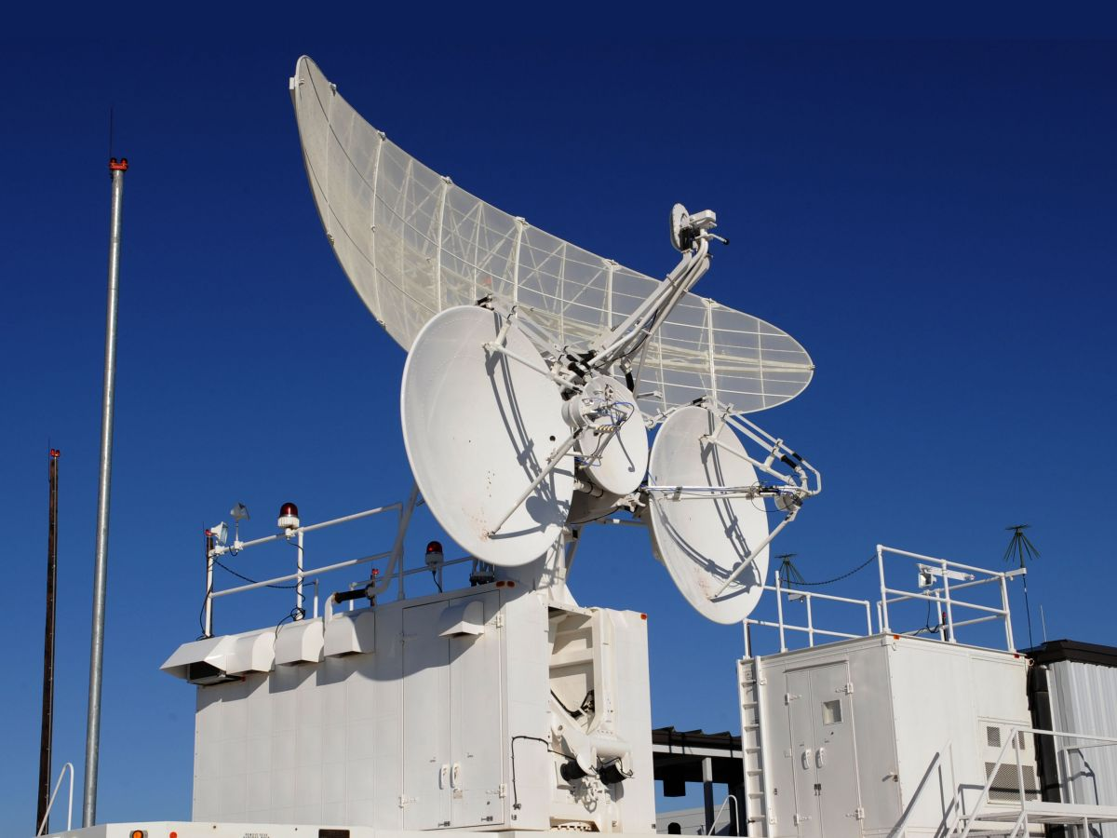
Hill AFB Space & C3I Opportunities
AN/FPQ-16
AN/FPS-85
AN/FPS-124
AN/FPS-123
AN/MST-T1

Slide 6
Power Supply: AS – Repair Hill AFB – 415 SCMS
MD: | AN/FPQ-16
TMS: | N/A
Noun: | Power Supply
NSN: | 6130-01-500-6331
P/N: | 11253790
Forecasted Buy Price: | $225,744.85
Forecasted Repair Cost: | $115,800.39
AAC: | C
Unserv. Assets Avail: | N/A
QPA/APPL Rate: | 18 | 100%
AMC/AMSC: | N/A | N/A
RMC/RMSC: | 1 | R
Material: | Metal, wires, cooling fluid, electrical parts
Dimensions: | 41.5"L X 64"W X 93"H, 13,400LBS
Drawings Releasable: | See note on Slide 2
Drawing #: | Not Available
Drawing Cage Code: | Not Available
T.O. Releasable: | Yes
T.O. #: | 31P2-2FPQ16-432-1 and -2
Budget Code: | 8
Next Higher Asmbly: | Radar Transmitter - 11257402
Out Year Requirements: BUY
FY25: | 0 | FY26: | 0 | FY27: | 0 | FY28: | 0 | FY29: | 0
Out Year Requirements: REPAIR
FY25: | 1-2 | FY26: | 0 | FY27: | 0 | FY28: | 0 | FY29: | 0
EDL: | Not Available |  |  |  |  | RDL: | Available
Tinker | ------ |  |  |  |  | Robins | ------
Hill | 12/6/2024 |  |  |  |  | Virtual | ------
Comments
Deliverables: Source Approval Request (SAR)
Interested vendors should submit a Source Approval Request (SAR) to AFSC.OL.SB@us.af.mil and include your email address and “request a drop off.” A request for drop off will be returned, use this to submit your SAR package.

Slide 7
Power Supply: AS – Repair Hill AFB – 415 SCMS
Additional Comments
We are facing obsolescence issues with this NSN. The OEM is no longer interested in manufacturing this item and/or has gone out of business. No form-fit-function replacement for this item exists and all attempts to find one via independent market research have failed. We are looking for a vendor who would be willing to manufacture and/or repair this item for us.
Drawing not in JEDMICS, but can be provided under certain conditions.

Slide 8
Additional Hill AFB Space & C3I Opportunities
Control Indicator: AS – New Buy – AN/FPS-85
NSN: 5895-00-442-8694, P/N: 2056351-0501
Circuit Card Assembly: AS – New Buy/Repair – AN/FPS-85
NSN: 5998-01-464-3866, P/N: 2052607-0501
Electronic Component: AS – New Buy – AN/FPS-85
NSN: 5998-00-420-6866, P/N: 2052601-0501
I/O Module: Market Research – AN/FPS-85
NSN: 5998-00-586-6701, P/N: R106247-01 or 778800-01
Multiplexer Switch Module: Market Research – AN/FPS-85
NSN: 6030-01-582-8092, P/N: R106255-01 or 778572-94
Oscillating Group: AS – New Buy – AN/FPS-85
NSN: 5955-00-054-5924, P/N: 2052607-0501

Slide 9
Additional Hill AFB Space & C3I Opportunities
Power Supply Board: AS – Repair – AN/FPS-85
NSN: 6130-01-455-3739, P/N: 9477820-10
Radio Frequency Amplifier: Reverse Engineering – AN/FPS-85
NSN: 5996-01-499-6546, P/N: D0412897-2 or BHE5819-300/3159A
Power Radio Divider: AS – New Buy – AN/FPS-123
NSN: 5895-01-331-4875, P/N: 953143
High Power Amplifier: AS – New Buy – AN/FPS-124
NSN: 5840-01-365-0160, P/N: 1216950-301
Signal Processor Power Supply: AS – New Buy – AN/FPS-124
NSN: 6130-01-369-1519, P/N: 35265
Radio Frequency Monitor: AS – New Buy – AN/FPS-124
NSN: 5895-01-365-6023, P/N: 1209910-201

Slide 10
Additional Hill AFB Space & C3I Opportunities
Azimuth Drive Assembly: AS – New Buy – AN/MST-T1 MUTES
NSN: 5895-01-130-6309, P/N: 112850-101
Gearbox Assembly: Market Research – AN/MST-T1 MUTES
NSN: NSL, P/N: 112850-102
Motor Brake Assembly: Market Research – AN/MST-T1 MUTES
NSN: NSL, P/N: 112855-101
Motor: Market Research – AN/MST-T1 MUTES
NSN: NSL, P/N: TT-5302A-100
Brake, External Release: Market Research – AN/MST-T1 MUTES
NSN: NSL, P/N: 112861-101
Elevation Drive Assembly: AS – New Buy – AN/MST-T1 MUTES
NSN: 5985-01-123-3897, P/N: 112856-101

Slide 11
Additional Hill AFB Space & C3I Opportunities
Brake, External: Market Research – AN/MST-T1 MUTES
NSN: NSL, P/N: 112861-102
Gearbox Assembly: Market Research – AN/MST-T1 MUTES
NSN: NSL, P/N: 111355-147
Motor Pinning Assembly: AS – New Buy – AN/MST-T1 MUTES
NSN: 6105-01-207-2701, P/N: 112856-111
Motor Tach: AS – New Buy – AN/MST-T1 MUTES
NSN: 6105-01-127-5663, P/N: 40800-3
Servo Amp Assembly: Market Research – AN/MST-T1 MUTES
NSN: NSL, P/N: 112900-101
Azimuth Motherboard: Market Research – AN/MST-T1 MUTES
NSN: NSL, P/N: 113153-102

Slide 12
Additional Hill AFB Space & C3I Opportunities
Elevation Motherboard: Market Research – AN/MST-T1 MUTES
NSN: NSL, P/N: 113153-101
Motor PM Servo: AS – New Buy – AN/MST-T1 MUTES
NSN: 6105-01-329-4767, P/N: DPM56PF4-K7714
Reducer, Speed: AS – New Buy – AN/MST-T1 MUTES
NSN: 3010-01-326-8932, P/N: 500-007059
Brake, 10 FT LB Torque: AS – New Buy – AN/MST-T1 MUTES
NSN: 6110-01-331-0698, P/N: 1-087-711-01-005
Brake, Stems: AS – New Buy – AN/MST-T1 MUTES
NSN: 6110-01-334-9536, P/N: 1-087-731-01-011
Reducer, Speed: AS – New Buy – AN/MST-T1 MUTES
NSN: 3010-01-326-8931, P/N: 500-007072

Slide 13
Additional Hill AFB Space & C3I Opportunities
Housing, Handwheel: Market Research – AN/MST-T1 MUTES
NSN: NSL, P/N: 400-007049-16
Motor, Servo: AS – New Buy – AN/MST-T1 MUTES
NSN: 6105-01-325-6234, P/N: DPM56DF4K7710
Servo Amp Assembly: AS – New Buy – AN/MST-T1 MUTES
NSN: 5996-01-327-7835, P/N: 820281

Slide 14
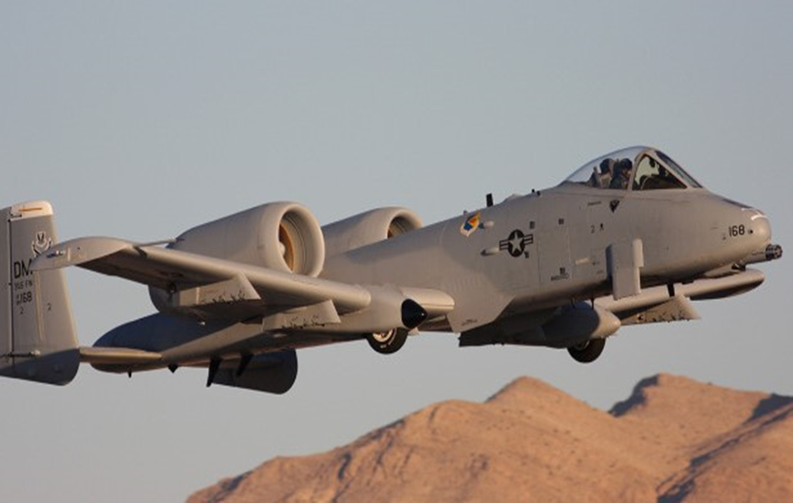

Tinker AFB Opportunities
A-10
KC-135

Slide 15
Prism, Optical: Market Research Tinker AFB – 422nd SCMS
MD: | A-10
TMS: | N/A
Noun: | Prism, Optical
NSN: | 6650-01-493-3660
P/N: | 2024166-44
Forecasted Buy Price: | Not Available
Forecasted Repair Cost: | Not Available
AAC: | Z
Unserv. Assets Avail: | No
QPA/APPL Rate: | Not Available | Not Available
AMC/AMSC: | 3 | Q
RMC/RMSC: | N/A | N/A
Material: | Crown Glass (JAN-G-174)
Dimensions: | Not Available
Drawings Releasable: | No
Drawing #: | N/A
Drawing Cage Code: | N/A
T.O. Releasable: | No
T.O. #: | Not Available
Budget Code: | 9
Next Higher Asmbly: | Not Available
Out Year Requirements: BUY
FY24: | 15 | FY25: | 6 | FY26: | 6 | FY27: | 6 | FY28: | 6
Out Year Requirements: REPAIR
FY24: | 0 | FY25: | 0 | FY26: | 0 | FY27: | 0 | FY28: | 0
EDL: | Not Available |  |  |  |  | RDL: | Not Available
Tinker | 08/08/2024 |  |  |  |  | Robins | ------
Hill | ------ |  |  |  |  | Virtual | ------
Comments
Interested vendors should submit a Capabilities Statement to 429SCMS.SASPO.Workflow@us.af.mil
No Source Approval Request (SAR) Package required

Slide 16
Additional Tinker AFB Opportunities
Control, Electric Light: AS – New Buy – KC-135
NSN: 6130-01-169-2192, P/N: PS413C or 458-50516-501
Control, Electric Light: AS – New Buy – KC-135
NSN: 6130-01-168-3562, P/N: PS413B or 458-50516-2

Slide 17
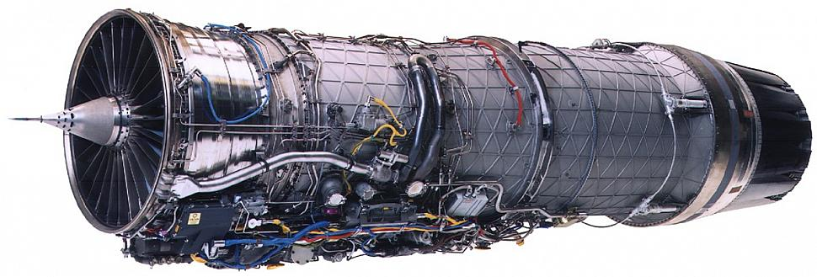
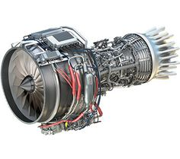
Tinker AFB Engine Opportunities

Slide 18
Retaining Strap: AS-New Buy Tinker AFB – 421st SCMS
MD: | N/A
TMS: | TF-34
Noun: | Retaining Strap
NSN: | 5340-01-553-6726
P/N: | 3034T18G02
Forecasted Buy Price: | $1.42
Forecasted Repair Cost: | N/A
AAC: | V
Unserv. Assets Avail: | No
QPA/APPL Rate: | 2 | 100%
AMC/AMSC: | 3 | Z
RMC/RMSC: | N/A | N/A
Material: | Corrosion Resisting Steel
Dimensions: | OL 5.510 IN. nom; OW 0.703 IN. nom; Thickness 0.063 IN. nom
Drawings Releasable: | Yes
Drawing #: | 3034T18
Drawing Cage Code: | 99207
T.O. Releasable: | Yes
T.O. #: | 2J-TF34-4
Budget Code: | 9
Next Higher Asmbly: | N/A
Out Year Requirements: BUY
FY25: | 491 | FY26: | 0 | FY27: | 0 | FY28: | 0 | FY29: | 0
Out Year Requirements: REPAIR
FY25: | 0 | FY26: | 0 | FY27: | 0 | FY28: | 0 | FY29: | 0
EDL: | Available |  |  |  |  | RDL: | Not Available
Tinker | 08/08/2024, 2022 |  |  |  |  | Robins | 03/29/2024, 2022
Hill | 12/06/2024, 2021 |  |  |  |  | Virtual | ------
Comments
Deliverables: Source Approval Request (SAR) Package
Interested vendors should submit a Source Approval Request (SAR) to dlaavnsmallbus@dla.mil
NOTE: Send notification to 429scms.SASPO.Workflow@us.af.mil within 45 days of intent to submit SAR package.

Slide 19
Additional Tinker AFB Engine Opportunities
Air Seal #3 Bearing - Market Research – F100
NSN: 2840-01-381-6850, P/N: 4080811
Divergent Segment - Market Research – F100
NSN: 2840-01-308-4465, P/N: 4071142
Duct, Compressor, Air 4th Stage - Market Research – F100
NSN: 2840-01-443-5588, P/N: 4082871-02
Duct, Compressor, Air 5th Stage - Market Research – F100
NSN: 2840-01-443-5589, P/N: 4082851
Duct, Compressor, Air 6th Stage - Market Research – F100
NSN: 2840-01-443-5590, P/N: 4082849
Duct, Compressor, Air 4th Stage - Market Research – F100
NSN: 2840-01-451-9636, P/N: 4082871-01

Slide 20
Additional Tinker AFB Engine Opportunities
7th Stage Stator - Market Research – F100
NSN: 2840-01-368-3960, P/N: 4083877-01
7th Stage Stator - Market Research – F100
NSN: 2840-01-368-6493, P/N: 4083877-02
7th Stage Stator - Market Research – F100
NSN: 2840-01-619-5781, P/N: 4089077-02
7th Stage Stator - Market Research – F100
NSN: 2840-01-619-3223, P/N: 4089077-01
9th Stage Stator - Market Research – F100
NSN: 2840-01-619-7382, P/N: 4089079-01
9th Stage Stator - Market Research – F100
NSN: 2840-01-368-0006, P/N: 4083979-01

Slide 21
Additional Tinker AFB Engine Opportunities
10-12th Stage Stator - Market Research – F100
NSN: 2840-01-619-7385, P/N: 4089080-04
10-12th Stage Stator - Market Research – F100
NSN: 2840-01-619-7383, P/N: 4089080-01
10-12th Stage Stator - Market Research – F100
NSN: 2840-01-619-4075, P/N: 4089080-03
10-12th Stage Stator - Market Research – F100
NSN: 2840-01-619-4072, P/N: 4089080-02
10-12th Stage Stator - Market Research – F100
NSN: 2840-01-369-6008, P/N: 4083880-01
10-12th Stage Stator - Market Research – F100
NSN: 2840-01-369-1666, P/N: 4083880-03

Slide 22
Additional Tinker AFB Engine Opportunities
10-12th Stage Stator - Market Research – F100
NSN: 2840-01-365-6878, P/N: 4083880-04
10-12th Stage Stator - Market Research – F100
NSN: 2840-01-365-2209, P/N: 4083880-02
4th Stage Vane - Market Research – F100
NSN: 2840-01-317-2242, P/N: 4075854 / 4075974
5th Stage Vane, Compressor - Market Research – F100
NSN: 2840-01-365-0119, P/N: 4080325
6th Stage Vane - Market Research – F100
NSN: 2840-01-344-9149, P/N: 4080256 / 4079696
Inlet Guide Vane - Market Research – F100
NSN: 2840-01-321-4455, P/N: 4077250

Slide 23
Additional Tinker AFB Engine Opportunities
Duct, Compressor, Air - Market Research – F100
NSN: 2840-01-445-5777, P/N: 4082848

Slide 24
Acronym Legend
AAC – Acquisition Advice Code
AMC – Acquisition Method Code
AMSC – Acquisition Method Suffix Code
APPL – Application Rate
AS – Alternate Source
Asmbly - Assembly
MD – Mission Designation (Aircraft Type)
N/A – Not Applicable
NSN – National Stock Number
OTA – Other Transactional Authority
QPA – Quantity Per Assembly

Slide 25
Acronym Legend
Rev Eng – Reverse Engineer
RMC – Repair Method Code
RMSC – Repair Method Suffix Code
TMS – Type, Model and Series (Engines Only)
T.O. – Technical Order
Unserv. Assets Avail – Unserviceable Assets Available

